Slide 1
AIR HOCKEY GAME
University Of Karachi
Department Of Computer Science
Group Members:
Wajeeha Parker : B15101151
Aruba Tajwar : B15101018
Bushra Iqbal : B15101027
Subika Imam Abidi : B15101145
Course Supervisor: Dr. Humera Tariq

Slide 2
INTRODUCTION
This is a two player Air Hockey Game.
The game uses Cyrusbeck Algorithm to implement reflection of ball by the walls.
This game is implemented on the 2D scene.

Slide 3
OBJECTIVE
Objective of the project is to design a 2D Air Hockey game using reflection vector and Cyrusbeck algorithm

Slide 4
PROJECT DESCRIPTION
AIR HOCKEY

Slide 5
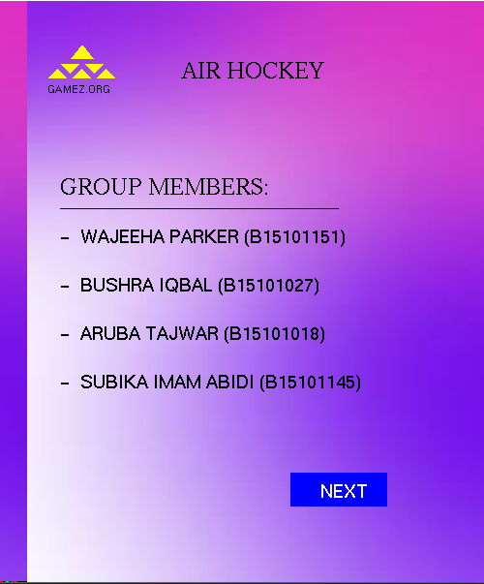
MAIN SCREEN
the first screen gives the name of projects and team members.
The button ‘NEXT’ on click takes you to the next screen.

Slide 6
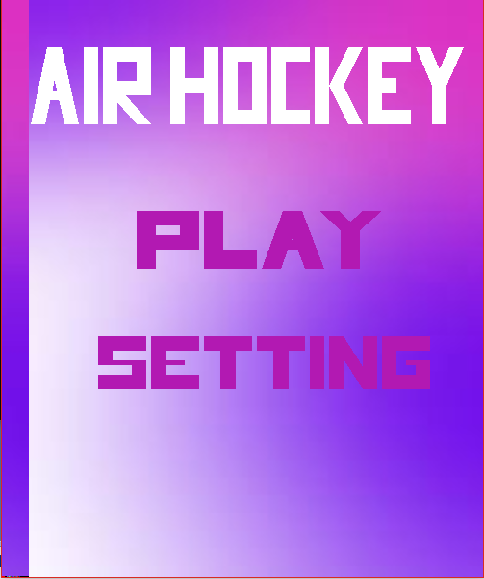
SECOND SCREEN
this sreen provides two options to the user.
The letters displayed on this screen are pure 2D shapes.
‘PLAY’ takes you directly to the game.
‘SETTINGS’ take you to the setting screen.

Slide 7
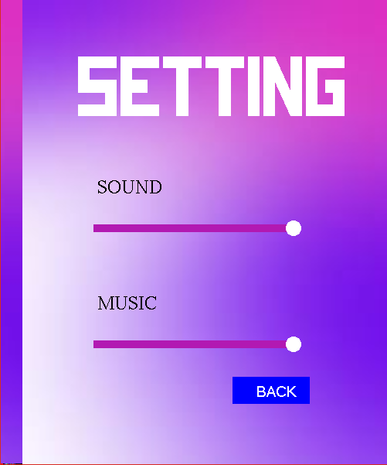
SETTINGS
the game provides two settings to the users, ‘sound’ and ‘music’
The settings could be changed with mouse operations.
‘BACK’ button takes you back to the second screen.

Slide 8
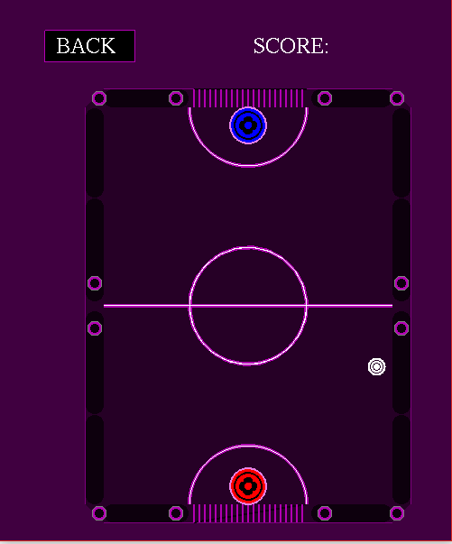
GAME SCREEN
The main game screen uses two types of control operations.
Mouse click operation is used by ‘BACK’ button.
The strikers are controlled by keyboard buttons: ASWZ for red and JKIM for blue striker.
This screen is implemented purely from 2D shapes.

Slide 9
INPUT
Input is provided with the help of mouse and keyboard operations.
Mouse operations are used by the buttons.
Keyboard operations are used by the striker. Red striker uses ASWZ keys, whereas blue striker uses JKIM keys.

Slide 10
OBJECT CLASSES
BALL:
This class is used to control the ball in the game.
This class takes in the location and direction and sets the ball to that location and sets the direction as ball direction.
STRIKER:
This class controls the position of the two strikers, red and blue.
The position is changed by keyboard keys.

Slide 11
RGBApixMap:
This class is used to load the background image in this project.
RAY:
This class is used to give direction to the ball.

Slide 12
Learning and Achievements
We worked with reflection vector and Cyrus beck algorithm.
We experienced working with different shapes and how to draw them.
This project is designed purely for the entertainment of users.

